Slide 1
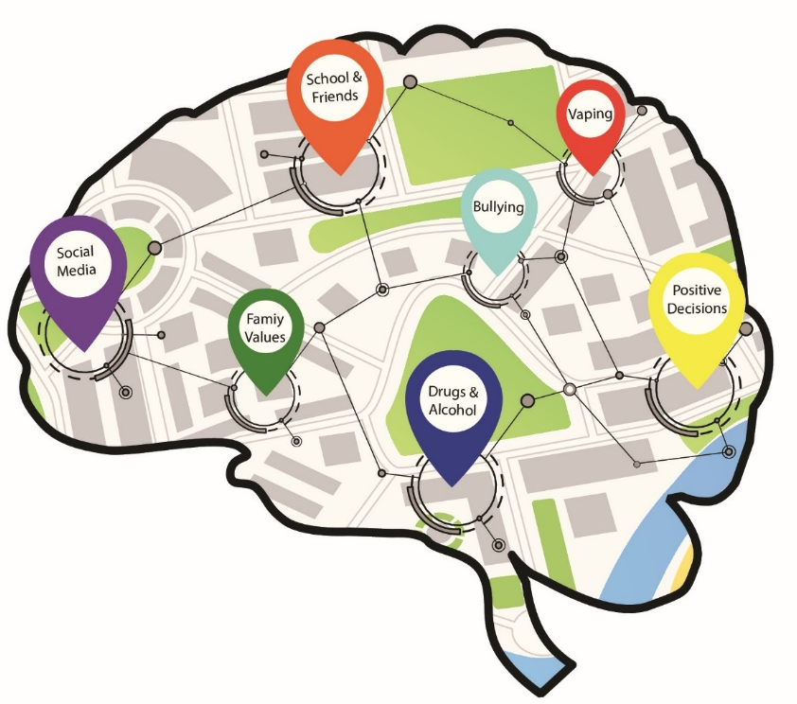
BrainAbouts: About the Brain

Slide 2
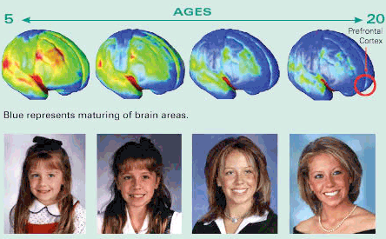
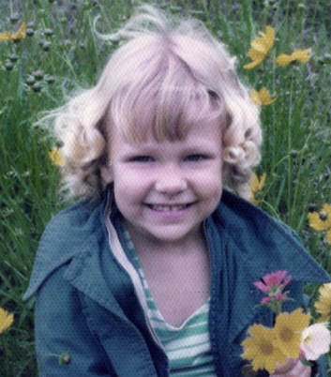
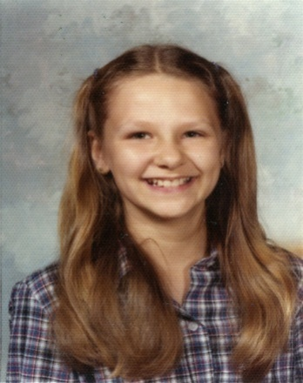



Slide 3
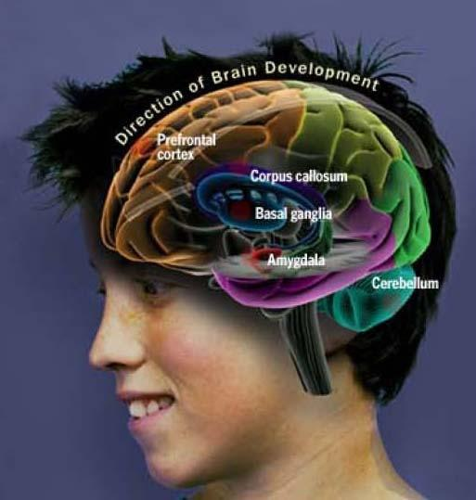
A teenager’s brain “has a well-developed accelerator but only a partly developed brake.”
Laurence
Steinberg
Discussion Question:
What does this mean? Do you agree or disagree? Why?
Notes:
Read slide and discuss.

Slide 4

Two Phases of
Brain
Development
Phase I:
Grow 200 Billion Neurons
Notes:
The brain undergoes two stages of brain development. The first phase involves growing 200 billion brain cells beginning at birth up to about age 11/12.

Slide 5
Phase II
11-12 24-25
200
100
Notes:
Phase two of brain development involves losing 50% of our neurons (brain cells) in a process called “pruning”. This process begins at about age 11/12 and ends at about age 24/25 when our adult brain is fully developed.

Slide 6
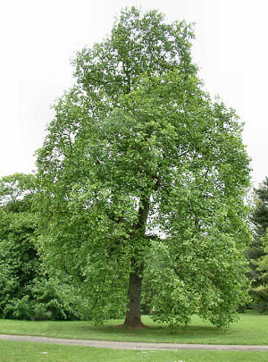
Notes:
A good analogy is that it’s kind of like growing a big, bushy tree in our brain from birth to about age 11/12.

Slide 7
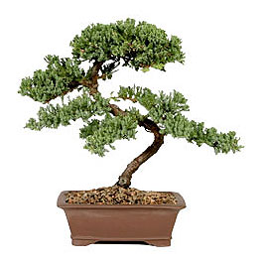
Notes:
Then, starting at about puberty, we begin to trim the tree down to something that looks very mature and polished…like a Bonzai tree.

Slide 8
Discussion Question:
Why Do We Lose 50% of Our Brain Cells?
To make room for two things:
Myelin
Dendrites

Slide 9
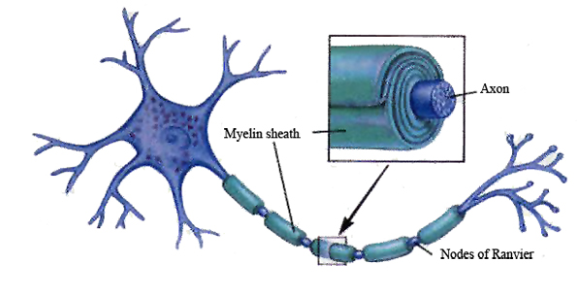
Myelin
= Processing Speed
Dendrites
= Learning
Notes:
These two things take up a lot of room. So, our brain starts pruning away cells to make room for them. Myelin or the Myelin sheath is a fatty tissue that covers the axons of our neurons (brain cells). It begins to thicken during adolescence. As myelin thickens, the electrical impulses move faster down the cell. This increases our processing speed or how fast we learn. Dendrites are like the hardware of learning in our brain. Every time we learn something new or practice something we have learned, our brain grows more dendrites that connect and make long pathways of cells. These pathways represent our skills. The longer neuronal pathways, the more skills we have.

Slide 10
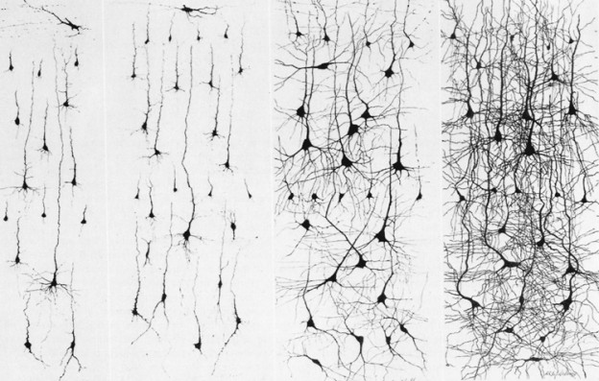

Slide 11
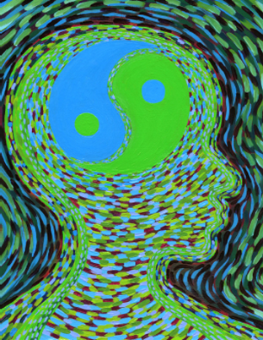
USE IT OR LOSE IT
PRINCIPLE
Pruning (Apoptosis) clears out unneeded wiring to make way for more efficient and faster information-processing (thicker myelin and longer dendrites)
Notes:
The brain decides which cells to prune and which cells to keep based on the Use It or Lose Principle. This principle states that when we use neurons (brain cells) our brain keeps these and grows long strings of pathways for that skill. The cells we do not use are the ones that get pruned away in a process scientifically known as Apoptosis.

Slide 12
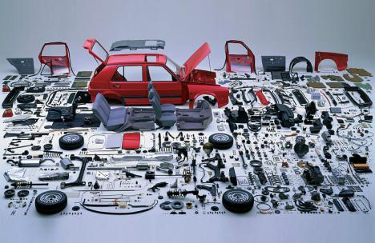
Notes:
It is like we get all the parts of our car (aka our brain) that we might need by the time we are 11/12.

Slide 13
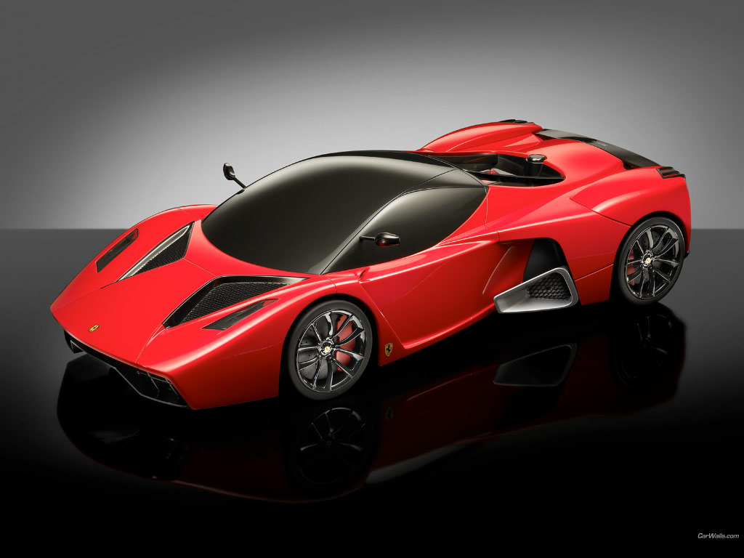
Notes:
We start putting those parts together and getting rid of the parts we don’t want or use. By age 24/25, we have a fast, efficient processing machine in our head full of the skills we have been using.

Slide 14
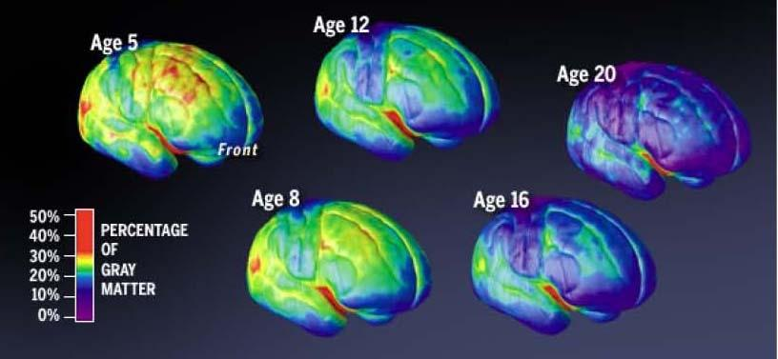
Notes:
This is a picture of what it looks like. This is a study conducted by Jay Geidd in 1999. He took functional MRI (brain pictures) of children as they grew and developed. You can see that a very particular part of the brain is growing and developing more than others. This part is called the Prefrontal Cortex or Frontal Lobes located in the top, front part of our head. When we are young (age 5-8), we have frontal lobes, but they are immature and underdeveloped…totally okay because we rely on our parents' frontal lobes. When we hit the second phase of brain development, about age 11/12, the frontal lobes begin to thicken with myelin and dendrites. We have about 15% of our adult brain at age 12, about 45% at age 16, and about 80% at age 20.

Slide 15
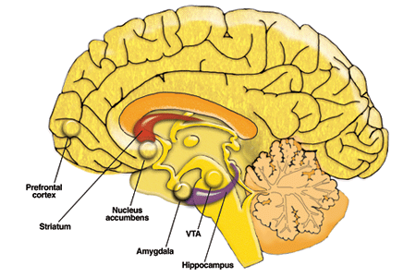
Prefrontal Cortex: Directs our judgment & decision-making (rational, mature thinking)
Limbic System: Directs our emotional response (reactions)
Notes:
The Prefrontal Cortex or Frontal Lobe is known as the “thinking” part of the brain that makes good decisions and acts maturely. It is important to distinguish it from the Limbic System located in the middle part of our brain. The Limbic System is known as the “reacting” part of the brain which reacts based on emotions. The Amygdala, a tiny organ in the Limbic System, senses threats and turns on the flight, fight, or freeze mechanism.

Slide 16
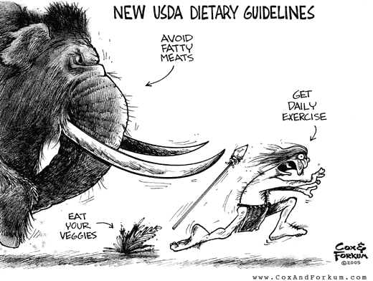
What does Limbic System Thinking do for you?
Notes:
The Limbic System is an old part of our brain, evolutionarily speaking. We have had this part of the brain since cave man days.

Slide 17
What is Limbic System Thinking?
Fight, Flight, Freeze Survival Mode
All or Nothing: Concrete
Based on fear or anger reactions
Ignited by real or perceived threats
Begins adrenaline cycle
Gives you calm and happy feelings when you do good things for survival
Notes:
The Limbic System or the “reactor” takes care of our survival by reacting quickly, thinking in concrete or black and white terms. It perceives when there is a threat in our environment and starts the adrenaline rolling so that we can react quickly and protect ourselves.

Slide 18
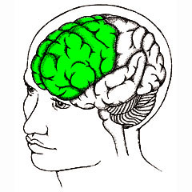
Executive Functioning
Elementary/Middle
Middle/High School
Task Initiation
Flexible Thinking
Planning and Prioritizing
Organization
Working Memory
Self-Monitoring
Selective Attention
Coordination
Abstract; conceptual understanding
Impulse Control
Problem-Solving
Decision-Making
Judgment
Emotion Regulation
Frustration Tolerance
Ability to Feel Empathy

Slide 19
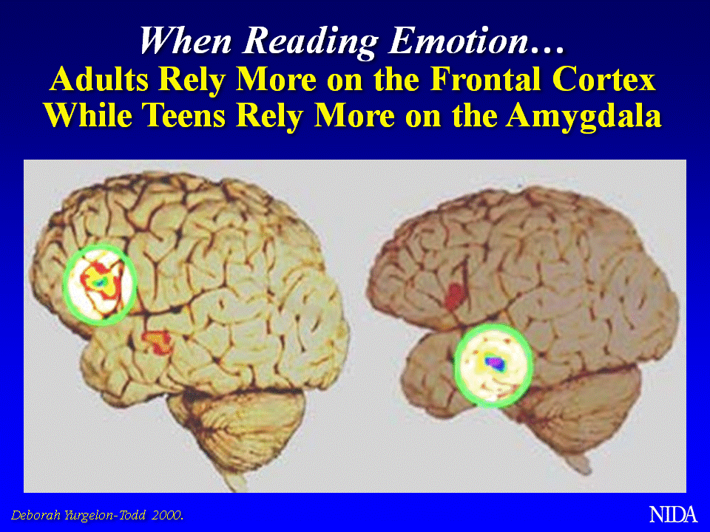
Discussion Question:
What problems might this cause?
Notes:
Sometimes, the limbic system reacts without coordinating with the frontal lobes, especially when we are younger. This study, conducted by NIDA in 2000, illustrates where electrical activity is located when adults vs teens read body language. Adults tend to use their frontal lobes to understand what people’s body language or facial expressions might be while teens tend to use their amygdala. This makes sense because a teen’s frontal lobe is still not fully developed yet but the amygdala is fully developed by age 11/12. Discuss what problems this might cause.

Slide 20
What DOES This Mean?
Adolescents on average are more:
Impulsive
Aggressive
Emotionally volatile
Likely to take risks
Vulnerable to peer pressure
Prone to focus on & overestimate short-term payoffs and underplay longer-term consequences of what they do
Likely to overlook alternative courses of action
Discussion Question:
Does this mean teens do NOT think before acting?

Slide 21
Adolescents ARE Smart…but
Teenagers ARE capable of rational decisions and knowing right from wrong
BUT, teenagers ARE more likely to act impulsively and with gut instinct when confronted with stressful, novel, or emotional decisions, without fully appreciating the immediate consequences of their actions
Discussion Question:
Has this ever applied to you? When?
How did you feel about it?

Slide 22
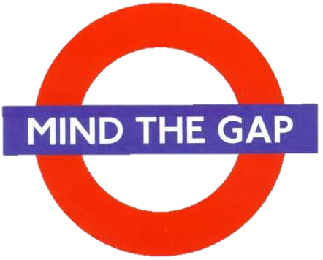
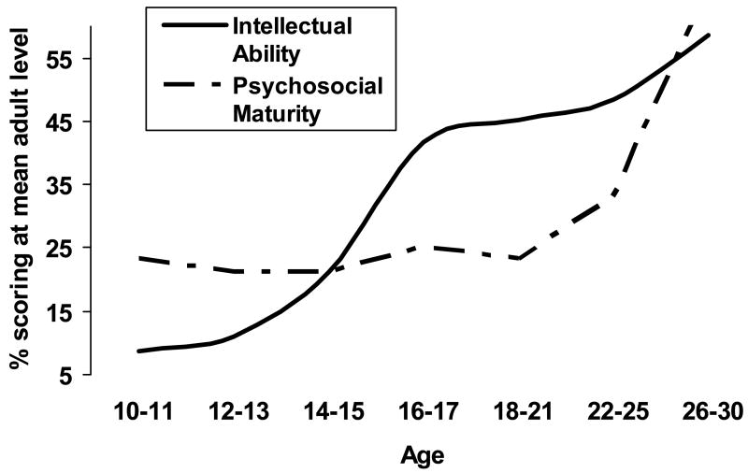
Notes:
This chart displays the trajectories of IQ (Intellectual Quotient) and EQ (Emotional Quotient or Intelligence or Psychosocial Maturity). IQ goes up starting at age 10 and peaks at 25. Psychosocial maturity, which is a measure of executive functions of the frontal lobes, stays flat until about 18 and then skyrockets up. We usually move out around 18 which requires us to use our brain cells and thus spurs executive function growth.

Slide 23
What does all this mean to you?
Are your parents justified in being your prefrontal cortex until yours is fully developed?
When is your PFC on?
When does your amygdala take over?
Do you underestimate the negative consequences of high-risk behavior?

Slide 24
Amazing Statistics
Students who wait to use drugs or alcohol until age 21, are likely NEVER to have problems with addiction during their lifetime.
Students who have a genetic predisposition to addiction and wait to use until age 21, are 40% less likely to have problems with addiction.
WHY?
SAMSHA, 2012
Notes:
A longitudinal study that tracked thousands of kids into their adulthood found that those who waited to use drugs or alcohol reduced or never had problems with addiction depending upon their genetics. The reason why: because they allowed their frontal lobes to grow which later made better decisions for them.

Slide 25
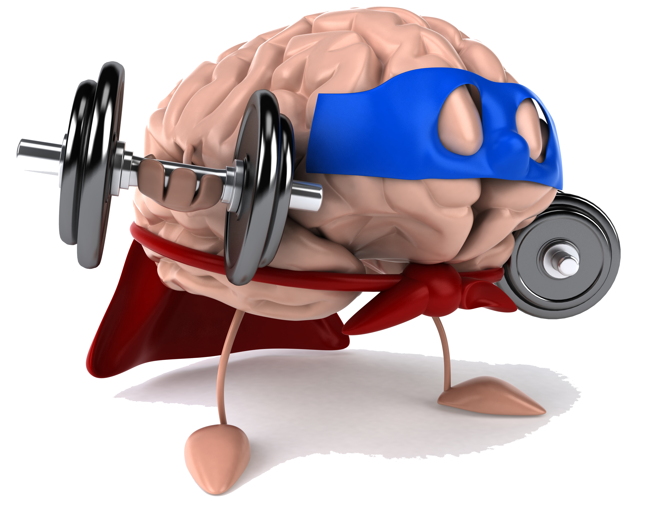
How do you take care of your Frontal Lobe?

