Slide 1
BrainAbouts: About the Amygdala

Slide 2
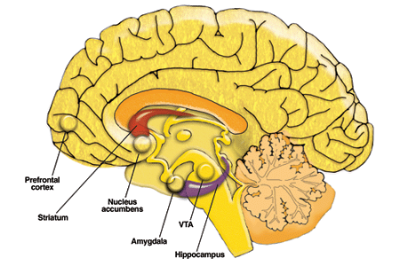
The Frontal Lobe or “Brake” governs impulse control & matures from age 11-25
The Amygdala or “Fight or Flight Switch” matures around age 11-12

Slide 3
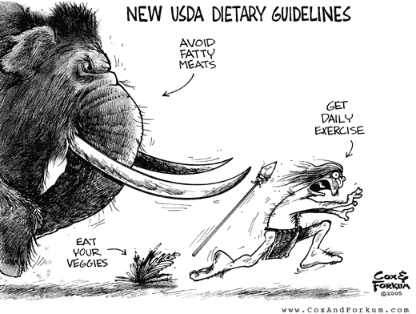
What does Amygdala Thinking do for you?

Slide 4
Anger/Fear Shut of PFC
How does this effect behavior?
Notes:
This is a 2-person fMRI. The 3 best photos were taken when this person was calm. The background 3 were taken from a person when they were very angry or scared, You can see how the frontal lobe goes off when we are in fear or extreme anger. We switch to combat or flight mode and stop using our top-level, executive-function skills.

Slide 5
Notes:
This study took fMRI X-rays while people read body language. You can see the frontal lobe is where adults read the emotion, but for teenagers the amygdala lights up. The frontal lobes are not fully developed yet, so it takes time to read body language with that part of the brain. This is why sometimes teens are quick to get angry or judge. They're using the part of the brain that develops, the limbic system. However, he is not the best thinker. He does a better job of reacting. This can get teens in trouble.

Slide 6
Top Down Control
When your Frontal Lobe turns on and turns off your Amygdala
Notes:
As the frontal lobes begin to grow and develop, they exert more control over the amygdala by turning on and off to regulate emotions and tolerate frustrations. This is called top-down control.

Slide 7
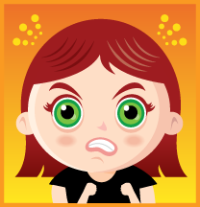
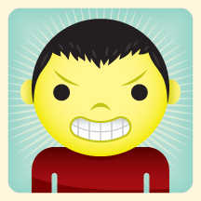
Do boys and girls express anger differently?
Girls use Relational Aggression more often
Withholding friendships, exclusion, gossiping
Boys use physical aggression more often
Shoving, pushing, damaging property

Slide 8
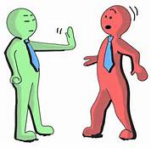
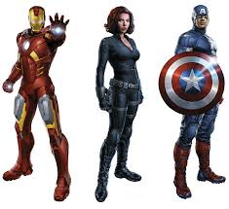
What is Your Anger Type?
The Clam
The Rocket
The Confronter
The Denier
The Avenger

Slide 9
The Rocket
Expresses anger with big blasts and fireworks
Acts out anger
Impulsive and reactive
Plenty of bottled up anger
Full of rage
Instantly reacts with vengeance
Don’t talk-just act

Slide 10
The Avenger
Seeks revenge
Carries a grudge
Broods for long periods of time
Want to get even for the anger they feel
Plot about how they will get even
Deny their anger-don’t talk

Slide 11
The Clam
Afraid that if they start to let out their anger, they won’t be able to control it
Holds anger inside
Sometimes they clam up because they fear losing something (e.g. a parent’s love)
Don’t want to rock the boat (commom in raging families)

Slide 12
The Denier
Withholds feelings but also is in need of being in control of situations
Deny that they are angry but they don’t want people to think they are out of control
Perfectionist
Don’t know how to label feelings in order to talk about them

Slide 13
The Confronter
Uses assertive language to express themselves
Has courage to talk about things even when it’s uncomfortable
Uses I statements, clearings, & other tools
Doesn’t blame; takes responsibility
Empowered and self-confident
Lives the healthiest lifestyle

Slide 14
Top Ten Anger Management Skills
10) Practice relaxation skills.
9) Use humor to release tensions.
8) Don't hold a grudge.
7) Use 'I' statements when describing the problem.
6) Identify solutions to the situation.

Slide 15
Top Ten Continued…
5) Think carefully before you say anything.
4) Get some exercise.
3) Once you're calm, express your anger.
2) Get some space.
1) Take a timeout.

Slide 16
Time Out
Leaving the situation can sometimes be the best option to avoid re-acting out of anger.
Assertively and politely ask for a few minutes away from the situation
Use “I” statements
Set a specific time frame to discuss the issue
(30 minutes, at 5 o’clock, tomorrow)
It will also help move your brain from amygdala functioning and into prefrontal cortex functioning.

Slide 17
What about in your house?
How is anger handled in your house?
Have you ever acted out of anger and later regretted it?
How could you have handled that differently?
Have you ever asked for a time out?

Slide 18
How do you take care of your Frontal Lobe?

