Slide 1
BrainAbouts: About the Nicotine

Slide 2
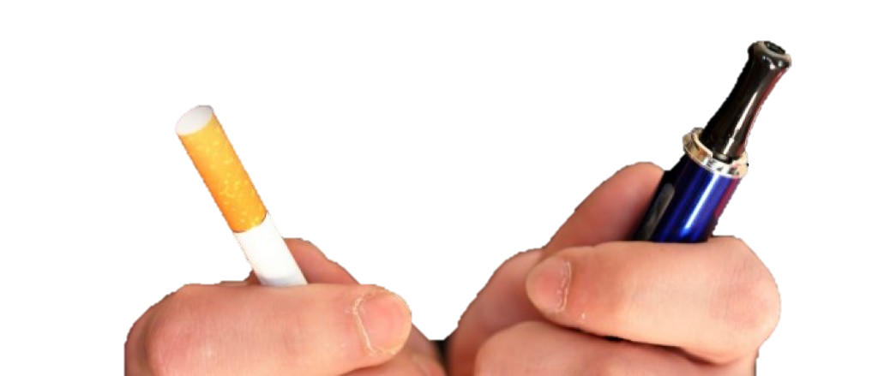
NICOTINE

Slide 3
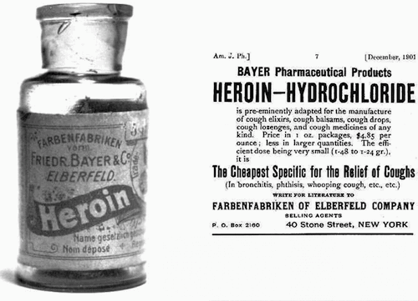
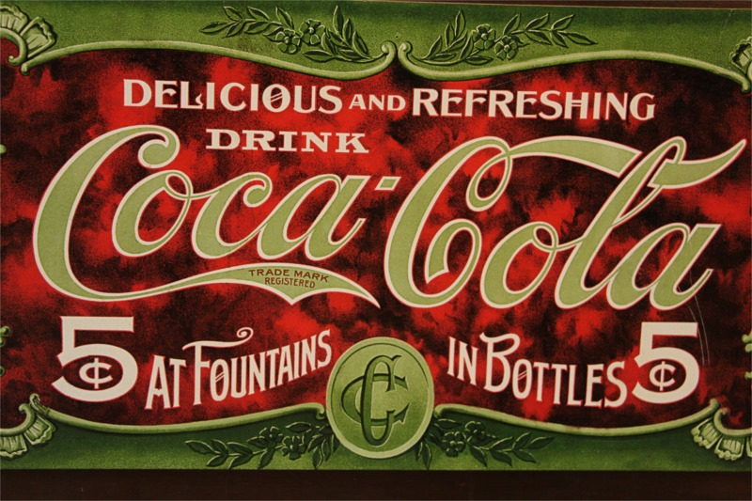
Late 1800’s
Heroin cough syrup was a “safe” over-the-counter children’s medicine…
Early 1900’s
Cocaine was an ingredient in Coca-Cola…a “safe” way to cure depression and indigestion…

Slide 4
Camel Cigarette Commercial 1950

Slide 5
Rationale for Development
Hon Lik developed in 2003.
His father died of lung cancer from smoking.
He wanted to provide a safer alternative and reduced the fire hazard of traditional cigarettes.
Notes:
He himself was a smoker, pharmacist, and inventor. In addition his father died from lung cancer.

Slide 6
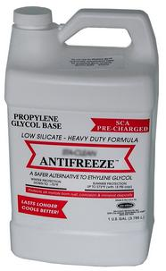
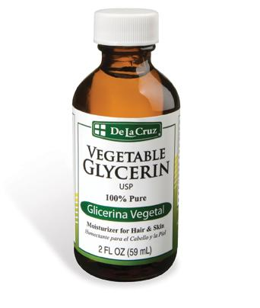
E-liquid is primarily composed of a combination of…
Propylene glycol
Vegetable glycerin
Nicotine (from 42 to 0 mg/mL)
Artificial flavorings
Notes:
Propylene glycol – primary component in fog machines and is also used as antifreeze. Designated as safe in mild doses, though there is not evidence that it is safe when inhaled. FDA recognizes it as “generally recognized as safe for food.” It is a synthetic liquid. Used to absorb extra water.
Vegetable glycerin creates larger clouds and denser vapor production because it has reduced throat hit compared to propylene glycol.
Vegetable glycerin – a fat that was previously used as antifreeze before propylene glycol came along which works better – also used as an artificial sweetener
50-60% of the nicotine in a cartridge is vaporized.

Slide 7
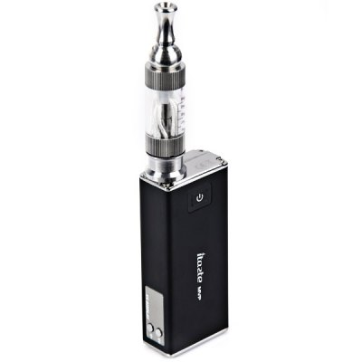
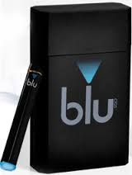
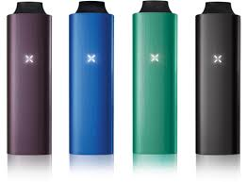
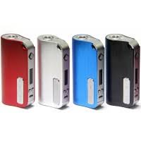
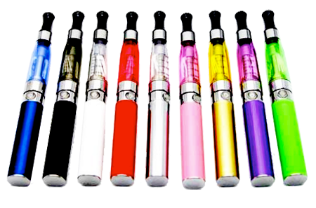
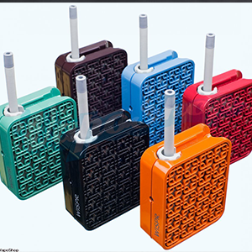
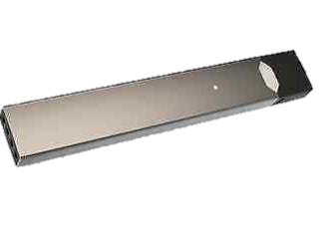
E-Cigarettes & Vaporizers

Slide 8
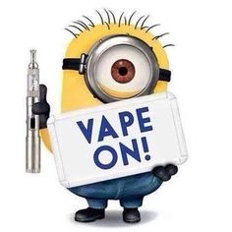
Advertisers Claims…
No offensive odors
Cheaper than smoking cigarettes (save 50-75%)
Can vape in more places
Safe alternative to traditional tobacco products
Reduce cigarette cravings and nicotine withdrawal symptoms
Notes:
The curiosity thing is based on a survey that was JUST released.

Slide 9
3600-5000 20-50
TOXIC CHEMCIALS
Notes:
Do you think this advertisement is misleading? They do not mention that there are 20 to 50 toxic chemicals in E liquid. That is less than the 3600 to 5000 toxic chemicals found in cigarettes however there are still toxic chemicals in E liquid not mentioned in this ad.

Slide 10
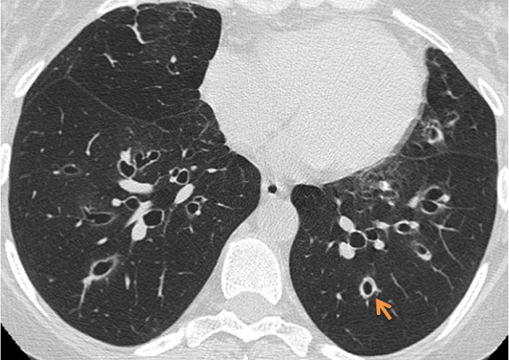
Dangerous Components/Emissions
Formaldehyde and acetaldehyde
Acrolein (eye & respiratory irritant)
Diacetyl – popcorn lung disease
Heavy metals
Ethylene glycol
Notes:
Formaldehyde and acetaldehyde produced from propylene glycol at high temperatures. I will tell the story of going to the head shop right here and how the guy made sure to sell us on the most recent models because they had an automatic sensor that shut them off if the temperature becomes too high. Toward end of a smoking session, the lack of liquid causes increased heat which can cause combustion leading to formaldehyde levels similar to that of cigarettes.
One study showed that the only toxic compound with a higher level in e-cigs versus cigarettes were heavy metals like tin and silicate beads. Tin exposure is associated with cardiac damage.
Ethylene glycol is a substitute for propylene glycol. Similar action except more toxic. The study noted they were not sure why it was used instead of propylene glycol.
Diacetyl is a food additive that has a buttery flavor. Has been shown to be safe for human consumption at minimal levels. There is a safety rating for workers in popcorn factories. One study tested 159 different sweet e-liquids and found that 25% of them contained diacetyl, some of which exceeded the amounts for popcorn factor workers. The researchers concluded that there was no reason to include the chemical because there are safer alternatives.
Popcorn lung disease is associated with cough and shortness of breath. It is similar to chronic obstructive pulmonary disease. Irreversible and involves scarring of the tiny air sacs in the lungs.

Slide 11
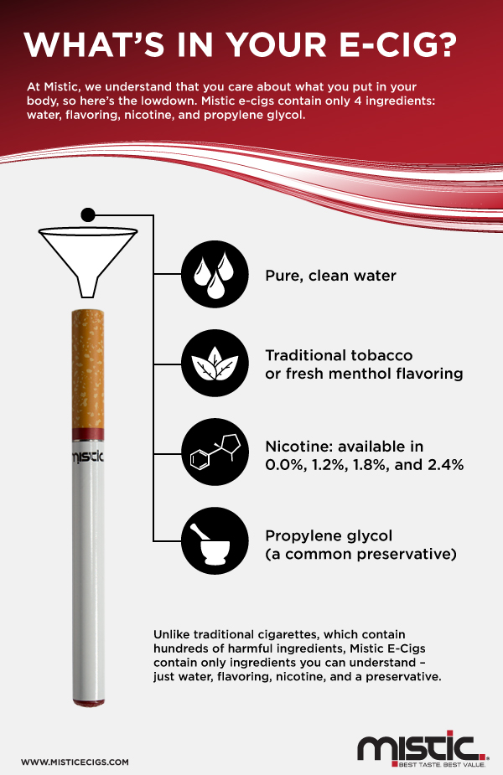
Notes:
This ad is misleading because they call propylene glycol a common preservative but do not mention that it is common to find it in chemical solvents not in items we put in our lung tissue

Slide 12
The World Health Organization (WHO) does not consider e-cigarettes to be a legitimate therapy to quit smoking. The percentage of people who quit smoking after trying e-cigarettes:
31%
Notes:
The World Health Organization reviewed studies most people who tried to quit smoking with E cigarettes and found that only 31% were able to switch which is not a very good quitting technique when compared to patches or gum

Slide 13
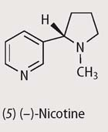
Nicotine
Most addictive substance
It takes 8 seconds to reach your brain and start making changes
One drop of pure nicotine would kill you
Nicotine is used in pesticides
The typical tobacco user spends over $2,000 a year on products
Smoking slows lung growth and reduces lung function
Causes heartbeat to be 3 times faster and breathing problems
Causes cancer & chronic lung disease
Arrests brain development

Slide 14
Juul advertises the use of nicotine salts that contain over 50%mg of nicotine per pod

Slide 15
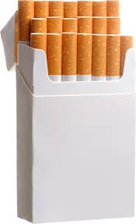
Juul advertises the use of nicotine salts that contain over 50%mg of nicotine per pod

Slide 16
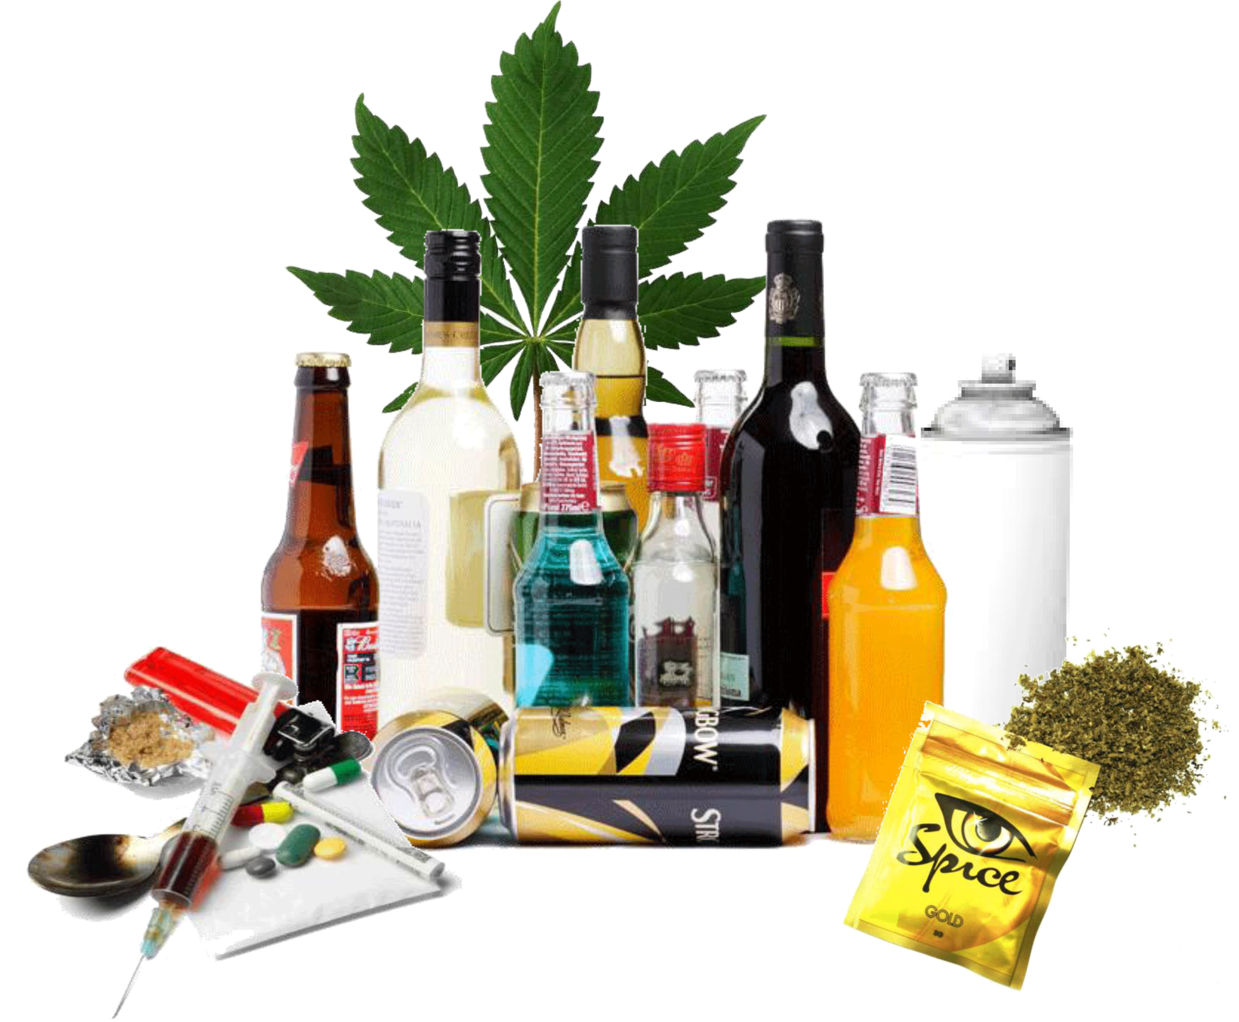
Teen smokers are
9 times more likely to abuse or become dependent on alcohol and 13 times more likely on illegal drugs
Nicotine = Gateway Drug

Slide 17
Why We Are So Attached to Nicotine
Release Glucose Stores
Release Insulin
Increase Basal Metabolic Rate
Increase in Acetylcholine
Rapid Release Adrenaline
Release of Dopamine & Glutamate
Release of Endorphins
Smoke

Slide 18
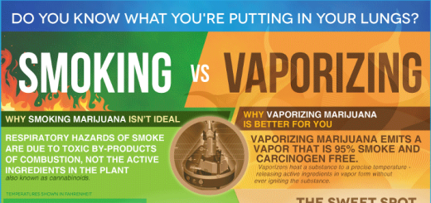
Notes:
This advertisement makes it sound like it's actually good for you to vape marijuana as opposed to smoking.

Slide 19
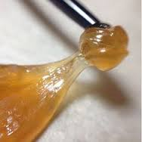
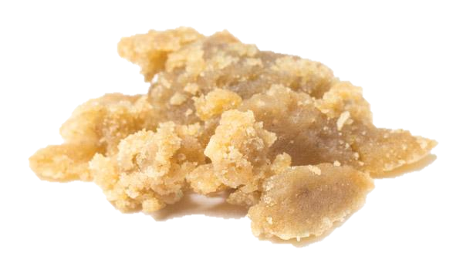
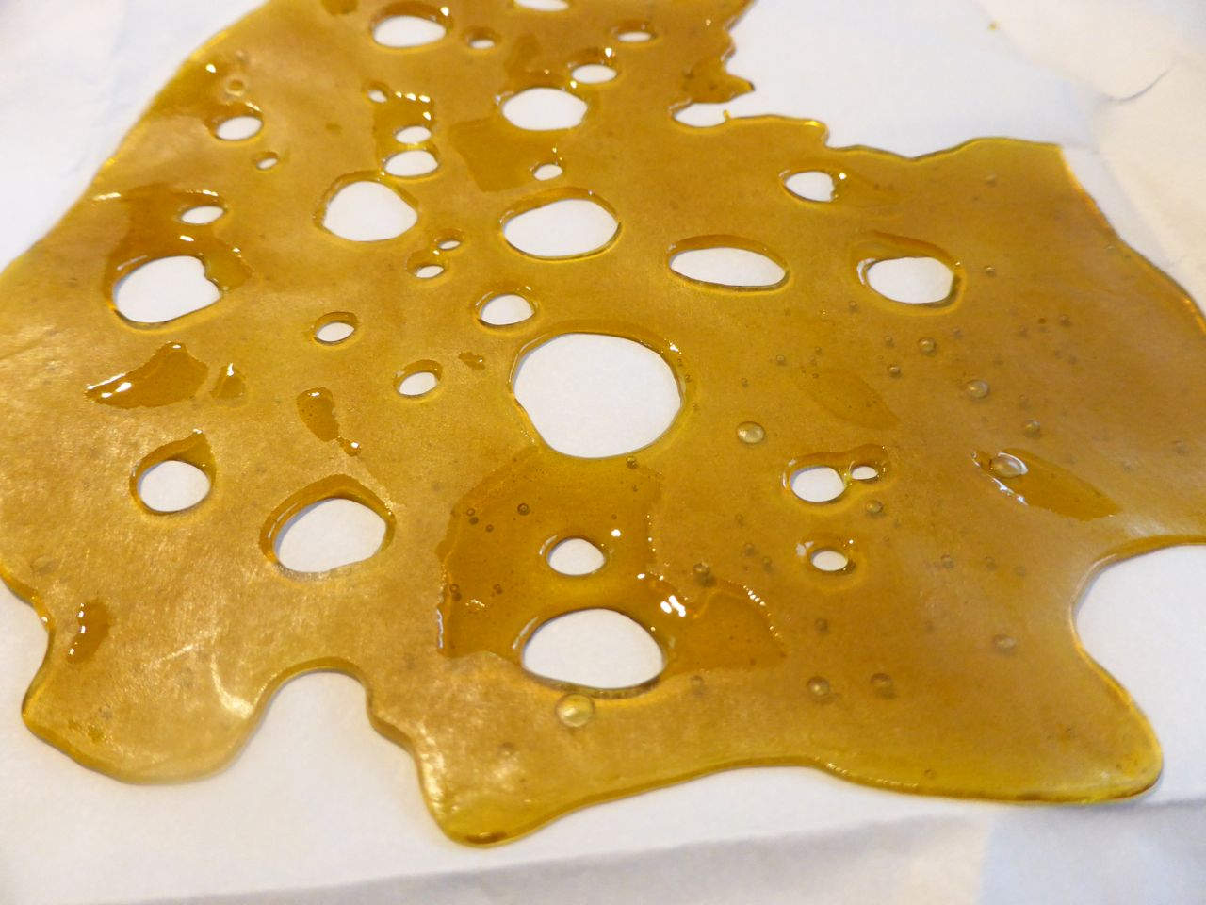
Marijuana Extracts
Dabbing: Smoking Hash Oil resins extracted from the marijuana plant made with butane.
Wax, Ear Wax, Oil, Honey Bowl, Butter, Dabs, Shatter
Notes:
A growing number of people are smoking marijuana out of e-cigarettes, NBC New Yorkreports. Marijuana in liquid and wax forms used in e-cigarettes and vapor pens does not create an odor. Because the devices don’t produce a flame, a person smoking marijuana in an e-cigarette can take a puff and then quickly put it in a pocket. –Join Together, Partnership For A Drug Free America

Slide 20
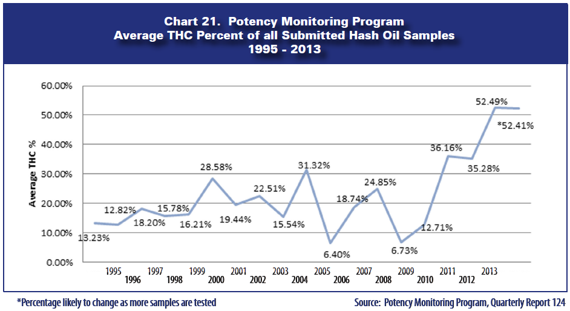
Notes:
National potency monitoring programs have determined that hash oil products have 3 to 4 sometimes 5 times more THC than the green leafy marijuana plant itself. This means that hash oil products are up to 5 times more addictive than smoking the green leafy Bud.

Slide 21
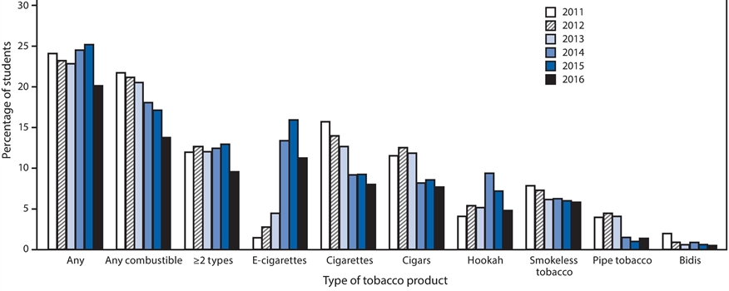
We are learning…
Current use: United States Middle School Students
Current use: United States High School Students
Notes:
We are learning as you can see by the graphs above. Adolescent cigarette use an vaping use is decreasing as more and more teens learn the dangers of both.

Slide 22
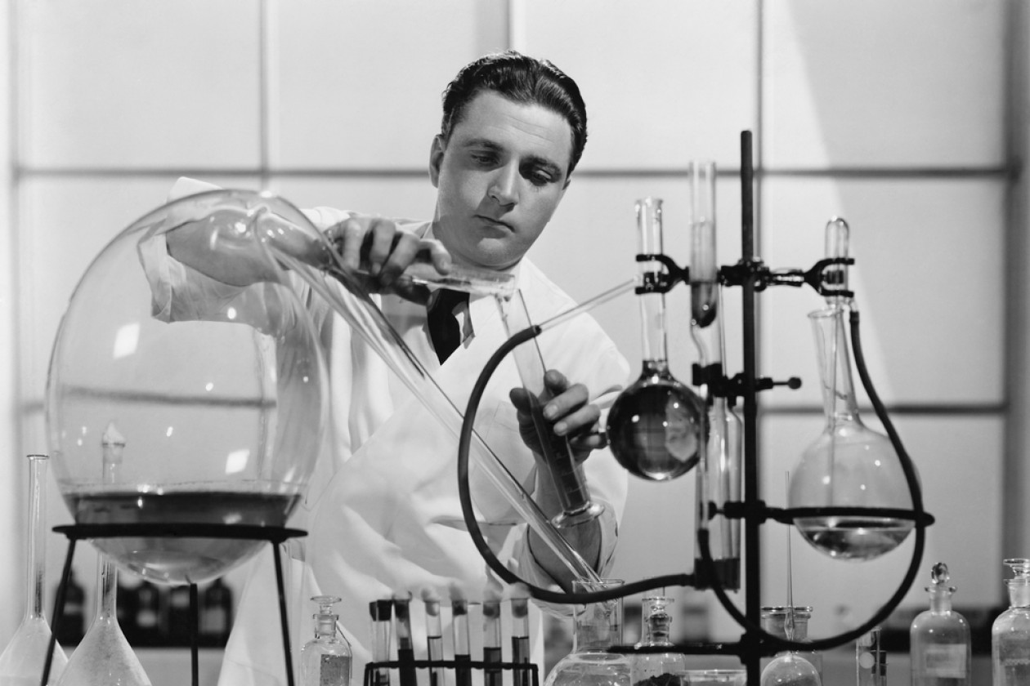
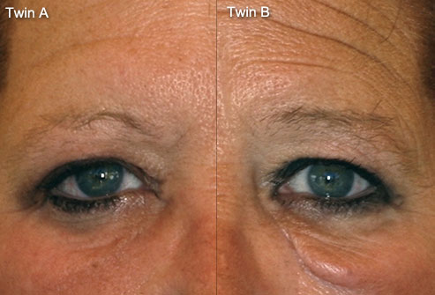
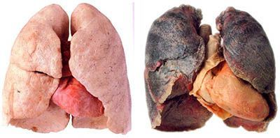
Notes:
Is history really repeating itself? Do we need to learn lessons all over again or can we look into history to see the effects of nicotine and smoking on our health?

Slide 23
DISCUSSION:
Did you start smoking or vaping first?
Why did you start? Curiosity? To Fit In?
Have you noticed any negative effects from smoking or vaping?
Do you think you are addicted to nicotine?

Slide 24
How do you take care of your Frontal Lobe?

