Slide 1
BrainAbouts:
About the Brain and Risky Behavior

Slide 2
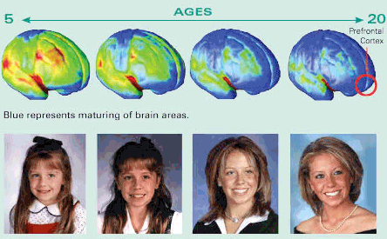
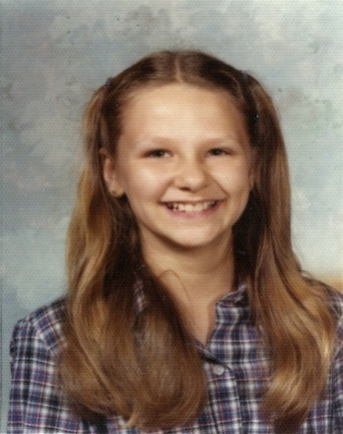

Slide 3
Neuroscience of Risky Behavior Why Should I Care?

Slide 4
About the Brain Re-Cap
How many brain cells do we have at age 11?
How many brain cells do we have at age 25?
What substance is thickening during this time?
What does that substance do for us?
What principle governs what cells stay and what cells get pruned away?
What part of the brain is thickening? What does that part of the brain do for us?

Slide 5
AGE 11-12 24-25
200
100
Notes:
We once thought the human brain was fully developed by age 5. Now we know that we actually grow an EXCESSIVE number of connections between brain cells during childhood. At age 11-12, we begin pruning back these connections. This process clears out unneeded wiring to make for more efficient and faster information-processing, otherwise known as mature, adult thinking. Age 11 for girls and 12 ½ for boys.

Slide 6
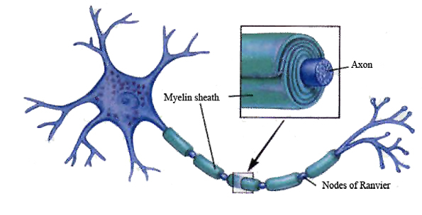
Myelin
= Processing Speed
Dendrites
= Learning
Notes:
RE-CAP: These two things take up a lot of room. So, our brain starts pruning away cells to make room for them. Myelin or the Myelin sheath is a fatty tissue that covers the axons of our neurons (brain cells). It begins to thicken during adolescence. As myelin thickens, the electrical impulses move faster down the cell. This increases our processing speed or how fast we learn. Dendrites are like the hardware of learning in our brain. Every time we learn something new or practice something we have learned, our brain grows more dendrites that connect and make long pathways of cells. These pathways represent our skills. The longer neuronal pathways, the more skills we have.

Slide 8
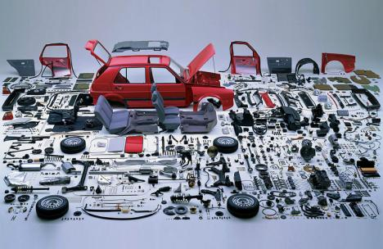
Notes:
RE-CAP: In Phase I of brain development, it is like we get all the parts of our car (aka our brain) that we might need by the time we are 11/12.

Slide 9
Notes:
RE-CAP: At the beginning of Phase II of brain development around age 11/12, we start putting those parts together and getting rid of the parts we don’t want or use. By age 24/25 when Phase II completes, we have a fast, efficient processing machine in our head full of the skills we have been using.

Slide 10
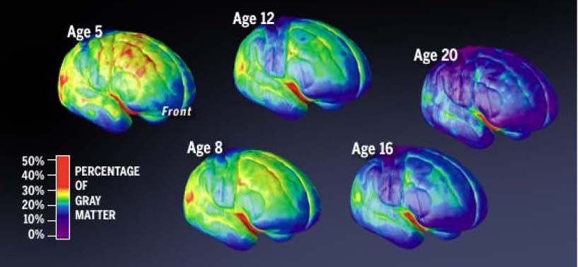
Notes:
RE-CAP: You can see that a very particular part of the brain is growing and developing more than others. This part is called the Prefrontal Cortex or Frontal Lobes located in the top, front part of our head. When we are young (age 5-8), we have frontal lobes, but they are immature and underdeveloped…totally okay because we rely on our parents' frontal lobes. When we hit the second phase of brain development, about age 11/12, the frontal lobes begin to thicken with myelin and dendrites. We have about 15% of our adult brain at age 12, about 45% at age 16, and about 80% at age 20.

Slide 11
Or lose it

Slide 12
Executive Functioning
Elementary/Middle
Middle/High School
Task Initiation
Flexible Thinking
Planning and Prioritizing
Organization
Working Memory
Self-Monitoring
Selective Attention
Coordination
Abstract; conceptual understanding
Impulse Control
Problem-Solving
Decision-Making
Judgment
Emotion Regulation
Frustration Tolerance
Ability to Feel Empathy
Notes:
Our frontal lobes or prefrontal cortex helps us move from immature, child-like responses to mature, adult thinking. This is the road to Executive Functioning or growing executive functioning skills. The frontal lobes serve as the CEO of our brain. It is where all higher-level thinking and processing live. There are two levels of executive functioning skills. The lower level more basic skills are the first to come online in elementary and middle school. The higher level more sophisticated skills grow during middle/high/college years.

Slide 13
How do alcohol/drugs and other high-risk behaviors effect the brain during the pruning process?
Notes:
Now, let’s answer this question.

Slide 14
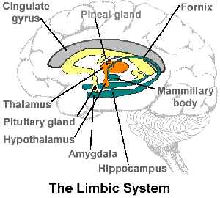
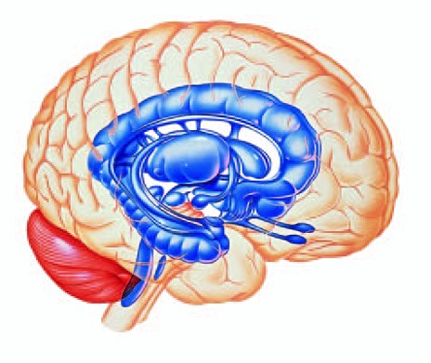
Limbic System
Survival: Fight or Flight
Pleasurable Experiences
Notes:
In order to answer this question, we must learn about another part of the brain known as the limbic system. The limbic system is located deep inside the brain protected by the myelinated lobes. The limbic system does two major things for us: 1) it is where all fight or flight, survival responses emanate from and 2) it is where all pleasurable experiences begin and end.

Slide 15
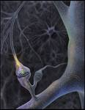
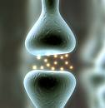
Dopamine: Calm, Happy, Signals Salience
Notes:
Now let's talk about the pleasure system. We cannot mention pleasure unless we mention the neurotransmitter dopamine. Dopamine makes you feel calm and happy when you've done something good for your survival that's why they say its signals salience. If something in your environment is good for your survival, it is salient and your limbic system acts as a feedback loop to let you know when you need to engage in a behavior that will keep you alive. Let me give you some examples.

Slide 16
Dopamine Release and the Hedonic (pleasure) Threshold
Reward Deficiency Syndrome= make less dopamine

Slide 17
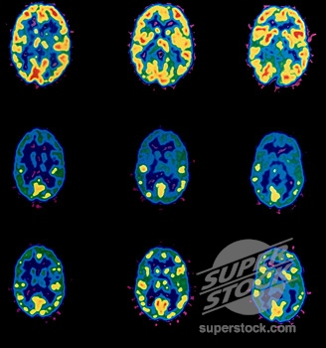
HYPOFRONTALITY = PLEASURE
IN BETWEEN Age 11-25 = ARREST
Notes:
This is what it looks like when the brain feels pleasure. It appears almost exactly like when the brain feels fear but for a completely different reason . Now, the brain thanks that you have done what you needed to do to survive therefore shutting off the frontal lobes because you don't need to think and plan anymore . You can just sit back and relax. An example might be how you feel after overeating on Thanksgiving Day. That wonderful ‘food coma/ feeling is actually an influx of dopamine in your limbic system making you feel calm and happy because you will keep yourself alive for the next 6-8 hours. It is OK to do this to yourself once in awhile however, what if you are an adolescent growing your frontal lobes? If your frontal lobes are off because of drug or alcohol use, do your frontal lobes get to grow? The answer is ‘no’ and it is called Arrested Development.

Slide 18
If you arrest here but stop using here
Age 12
Notes:
If you began using drugs and alcohol at age 12 and do not stop until age 20 and then had a picture taken of your brain, it would not look like the normal healthy brain of a 20-year-old. It may look more like the frontal lobe of a 16-year-old or maybe even at 12, 13 or 14-year-old depending upon how consistent your use was.

Slide 19
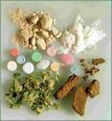
Dopamine-Releasing Chemicals
Alcohol & Sedative/Hypnotics
Opiates/Opioids
Cocaine
Amphetamines
Entactogens (MDMA)
Entheogens/Hallucinogens
Dissociants (PCP, Ketamine)
Cannabinoids
Inhalants
Nicotine
Caffeine
Anabolic-Androgenic Steroids
Notes:
19
There are many substances that can increase dopamine levels and thus become addictive.

Slide 20
Dopamine-Releasing Behaviors
Food (Bulimia & Binge Eating)
Sex, Relationships
Other People
(“Codependency,” Control)
Gambling
Video Games
Performance (“Workaholism”)
Collection/Accumulation (“Shopaholism”)
Rage/Violence
Social Media/Technology
Pornography
Cutting or Self-Injury
Notes:
20
There are also many behaviors that can increase dopamine levels and thus also become addictive.

Slide 21
When Dopamine surges so does Glutamate
to form memories and create motivation.
Notes:
21
When dopamine surges, so does another neurotransmitter called glutamate . Glutamate helps form memories. When dopamine surges glutamate will help your brain remember what is good for your survival so that you will do it again. However, this learning process is hijacked by substances that spike dopamine too high. When addiction occurs, the memory for the substance is strong and can lead to triggers. Because of glutamate, annex sometimes get triggered to use when there around places or People that they used to use with.

Slide 22
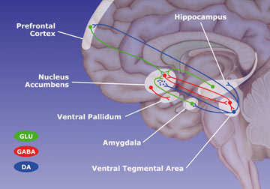
Reward Pathway
Notes:
The addiction process occurs in limbic system between the nucleus accumbens and the ventral tegmental area. Once these areas have seen structural changes caused by too much dopamine, they send a signal to the prefrontal cortex. This signal causes the addict to emotionally attach to the substance creating a psychological addiction to match the physical addiction.

Slide 23
Photo courtesy of Anna Rose Childress, Ph.D., NIDA website, 2007
Notes:
The memory and attachment once formed for drugs is very strong. This PET scan is part of a scientific study that compared recovering addicts, who had stopped using cocaine, with people who had no history of cocaine use. The study hoped to determine what parts of the brain are activated when drugs are craved. For this study, brain scans were performed while subjects watched two videos. The first video, a nondrug presentation, showed nature images - mountains, rivers, animals, flowers, trees. The second video showed cocaine and drug paraphernalia, such as pipes, needles, matches, and other items familiar to addicts.

Slide 24
Photo courtesy of Anna Rose Childress, Ph.D., NIDA website, 2007
Notes:
It takes a long time to heal. The middle picture displays a cocaine abuser who's been sober for 10 days. As you can see the frontal lobes are still quite off as this person goes through detox. The bottom 3 pictures show the same person after 100 days or over 3 months of sobriety. The frontal lobes are healing but there's only about 50% blood flow moving through them. It takes about 18 months for this person to return to normal levels of functioning as seen at the top.

Slide 25
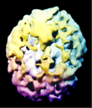
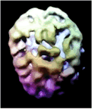
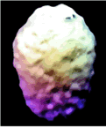
Normal Brain
Heroin Use
Good News…
Healing Happens
Do you know someone who suffers from addiction? What is their executive functioning like?
Alcoholic
17 Years
Abstinent
1 Year
Notes:
The good news is that the brain does heal although those structural changes usually never go away. The extra structures created by addiction may become dormant or inactive but there always lying in wait. For your average alcoholic it may take about 18 months to heal. For a heroin abuser it could take up to 5 years. This brain scan is called aspects can and it shows brain connectivity . In a normal healthy, brain most cells are connected and thus the scan will look smooth. For alcohol or heroin users, it is obvious that the brain connectivity is suffering. But after one year of abstinence the brain cells begin to heal and connect again.

Slide 26
How will you protect your Frontal Lobe?

