Slide 1
BrainAbouts: About Impulse Control

Slide 2
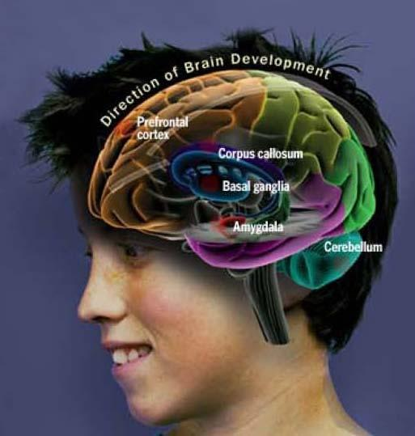
A teenager’s brain “has a well-developed accelerator but only a partly developed brake.”
— Laurence
Steinberg
What part of the brain is the accelerator?

Slide 3
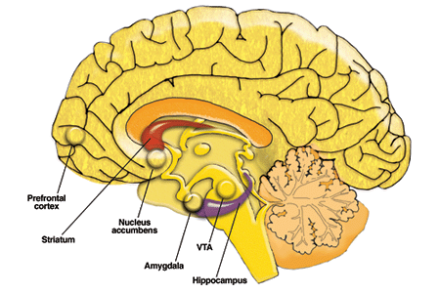
The Frontal Lobe or “Brake” governs impulse control & matures from age 11-25
The Nucleus Accumbens or “Accelerator” governs novelty seeking & matures around age 11-12
Are adolescents more sensitive to novel things?

Slide 4
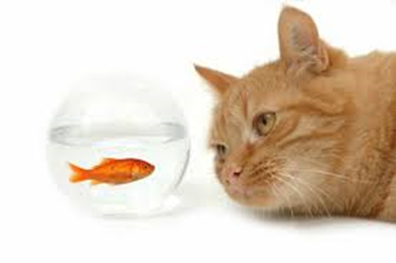
Self-Control — The ability to control your behavior regardless of what you are thinking or feeling.

Slide 5
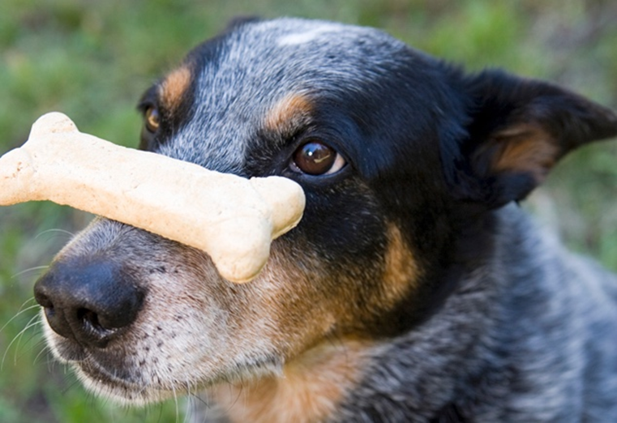
When is it hard for you to control your impulses?

Slide 6
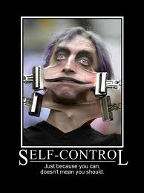
DISCUSSION TIME
What causes lack of
self-control?
Do you have any impulsive behaviors you would like to change?
Do you know people who have acted impulsively? What do they do? What is it like to be around them?

Slide 7
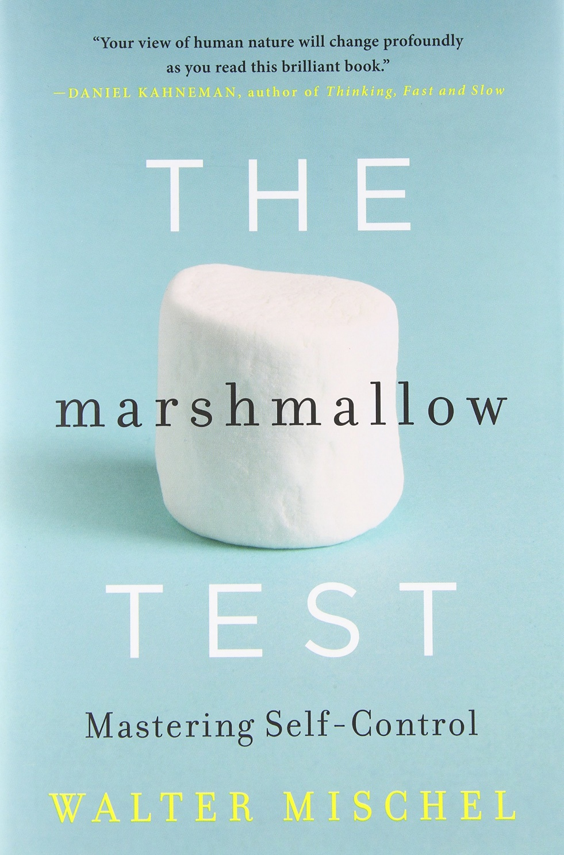
What is the #1 predictor of adult success?

Slide 9
#1 Predictor of Adult Success = Self-Control

Slide 10
Children who delayed longer on the marshmallow test grew up to…
Exhibit more self-control in frustrating situations
Give in less to temptation
Be less distractible when trying to concentrate
Be more self-reliant & confident
Trust their own judgment
Be less likely to get rattled, disorganized, and revert to immature behavior when stressed
Be more motivated to pursue their goals
Earn significantly higher SAT scores

Slide 11
Adults who delayed longer on the marshmallow test as a child…
Were more able to pursue and reach long-term goals
Used drugs and engaged in less risky behavior
Reached higher educational levels
Had significantly lower body mass index
Had higher relationship satisfaction
Had higher & more stable self-worth
Displayed distinctively more activity in their Frontal Lobes – which integrate motivational and control processes

Slide 12
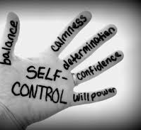
What impulse control techniques did the kids use in the video?
How do you achieve self-control?

Slide 13
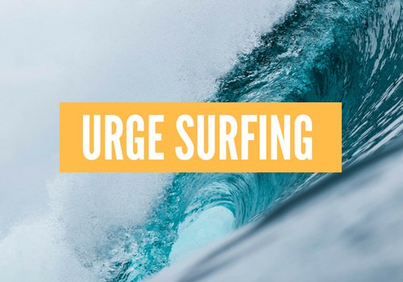
Notes:
You can’t stop the wave, but you can learn how to surf. —Jon Kabat Zinn

Slide 14
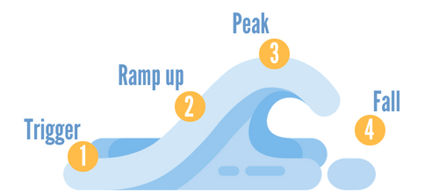

Slide 15
PAUSE
DISTRACT
BREATHE
BRAINSTORM
EVALUATE
ACT

Slide 16
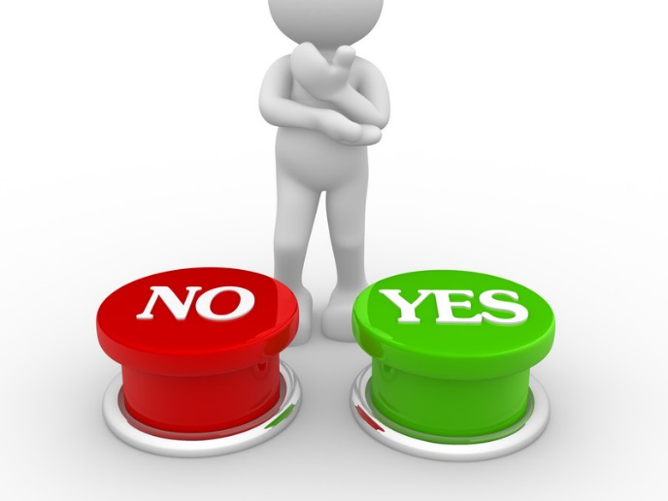
IMPULSE CONTROL SCENARIOS
Notes:
You have an impulse to play your new video game but need to do your homework. A group of friends have asked you to try a new drug. At the party, you could eat cake, pie or fruit.

Slide 17
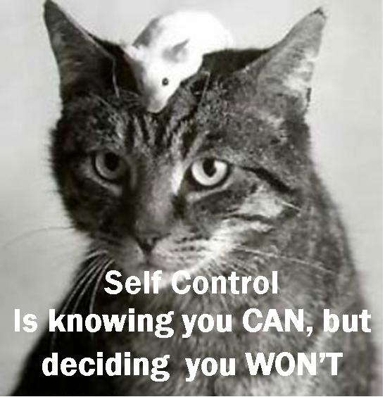
How does substance use contribute to poor
self-control?

Slide 18
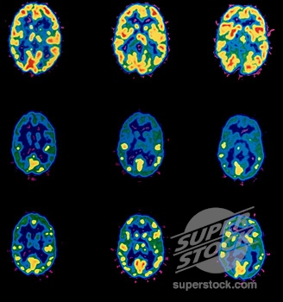
Notes:
During DA spikes, our midbrain lights up and our frontal lobe goes dark. Our survival system is now in charge of our brains. The thinking, good judgment part of our brain in inaccessible during active use. Does this explain why you can stop using but once you have ingested the chemical, you loose control?

Slide 19
Imagine yourself as you are right now. How confident are you that you would be able to resist the urge to use drugs if all your friends were? To use pornography if you were curious? To eat negative feelings away with high sugar or carbs? To study an hour more a day to bring a grade up?
Notes:
Brief Situational Confidence Questionnaire (BSCQ)
What is your profile?
In what situations are you most confident? Where are you? Who are you with?
In what situations are you least confident? Where are you? Who are you with?
Is there any specific situation where you know without a doubt you cannot control your impulses?
How does knowing your confidence level help you control impulses?

Slide 20
Your adult self will thank you when you practice self-control!

