Slide 1
BrainAbouts: About Marijuana

Slide 2
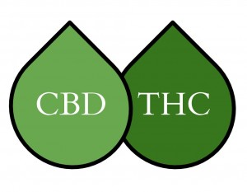

Slide 3
DEFS
CANNABIS: Cannabis Sativa L is a species of plant. Marijuana and hemp come from this species.
THC: delta-9 tetrahydrocannabinol is one of the 60 cannabinoids found in the Cannabis Sativa plant. It is marijuana’s primary psychoactive substances that causes intoxication.
CBD: Cannabidiol is a compound is one of the 60 cannabinoids found in the Cannabis Sativa plant. It is used medically for its ability to reduce pain and swelling. It is nonpsychoactive which means it is not intoxicating.
HEMP: The plant Cannabis Sativa cultivated for use in the production of a foods, beverages, personal care products, nutritional supplements, fabrics, textiles, paper, construction material, and industrial goods. Hemp is nonpsychoactive, generally contains high levels of CBD and no more than 0.3% THC. Hemp may be legally grown under a USDA-approved license if it contains less than 0.3% THC
MARIJUANA: The plant Cannabis Sativa cultivated as a psychoactive drug. Marijuana is psychoactive and there is no threshold for how much THC can be in it. The USDA does not approve licensure for marijuana grown with over 0.3% THC due to its high potential for drug use.

Slide 4
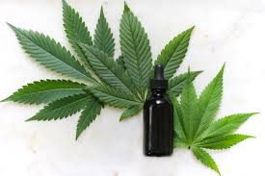
Marijuana…mimics our brain’s natural chemicals.
THC mimics other chemicals in your brain called cannabinoids that deal with appetite, pain, sensation, memory, and mood.

Slide 5
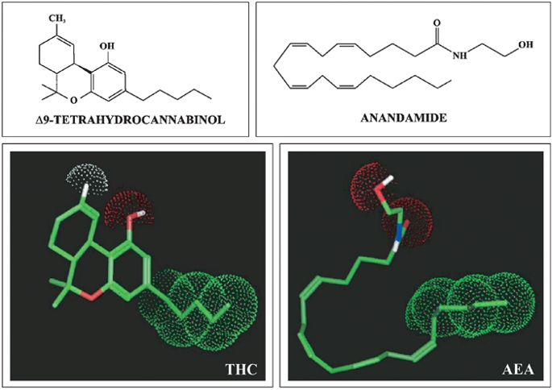
CANNABINOIDS
Chemical compounds that attach to receptors in the brain
Anandamide is an endocannabinoid that has many functions, including pain reduction, movement, depression, appetite, memory, and fertility.
THC, which is the psychoactive chemical in marijuana, mimics anandamide in the brain.

Slide 6
Weed Affects Cannabinoid Receptor Sites All Over the Brain
Hippocampus: important for short-term memory.
Cerebellum: controls coordination.
Basal ganglia: controls unconscious muscle movements.

Slide 7
Two Types of CB Brain Receptors
CB2: When bound, this receptor reduces pain and swelling.
CB1: When bound, this receptor produces euphoria.

Slide 8
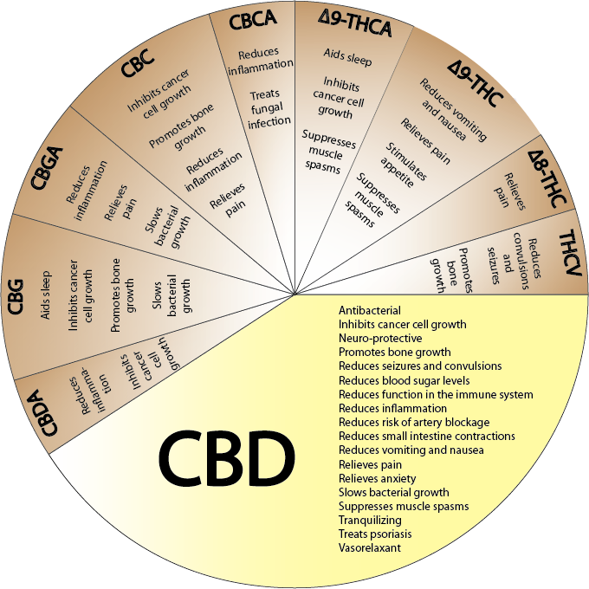

Slide 9
It is stronger today…how does this effect the brain?
Notes:
The marijuana manufacturing industry has been genetically modifying the amount of THC in marijuana plants, making it stronger and more addictive. However, at the same time, they have been decreasing the amount of CBD in order to reduce its modulating effects on THC. CBD is the medicinal part of marijuana. So, it is getting more addictive and less medicinal.

Slide 10
Effects of Marijuana
Short-term effects:
Altered senses, including time
Changes in mood
Euphoria, excitement
Impaired coordination
Sedation, drowsiness
Difficulty thinking and problem-solving
Impaired memory
Altered judgment
Hallucinations, delusions, psychosis
Phosphoric, anxiety, or paranoia
Long-term effects: Brain
Changed structure, functions, and chemical activity
Diminished executive function, attention, learning, memory, and motor skills
Diminished visuospatial functioning, verbal learning, short-term memory and cognitive function
Smaller brain regions, such as the hippocampus (memory region)
Reduction in expected developmental pruning

Slide 11
Effects of Marijuana
Long-term effects: Mental Health
Altered emotional functioning
Depression, anxiety, mania
Psychosis or paranoia
Increased risk of schizophrenia
Cannabis dependence
Lower life satisfaction
Overall lower lifetime achievement
Exacerbation of emerging or existing mental health issues
Physical Health
Sleep problems
Testicular cancer
Lung problems
Stroke
Drugged driving accidents
Increased developmental and mental disorders in children of mothers who used cannabis when pregnant
Academic/Career
Poor school or work performance
Potential loss or lower IQ and less crystallized intelligence

Slide 12
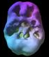
Normal
16 y/o — 2 year history of daily abuse. Underside surface view. Prefrontal and temporal lobe activity
18 y/o – 3 year history of 4 x week use. Underside surface view. Decreased PFC and temporal lobe activity
Notes:
This is a SPECT scan study that measures brain cell connectivity. In a healthy brain, the cells are well-connected depicted by a smooth scan. For the two subjects who used marijuana regularly, the scan indicates areas of the brain that did not fully connect. This shows their arrested development, especially in the frontal lobe area.

Slide 13
Frontal Lobe & Marijuana
Notes:
This fMRI scan displays slices of the brain taken while the person is awake. The “normal” scan is of a person who has not used marijuana compared to someone who has just used it. The darker the color, the more electrical activity and blood flow. The marijuana user shows significantly less activity, especially in the frontal lobe area of the brain.

Slide 14
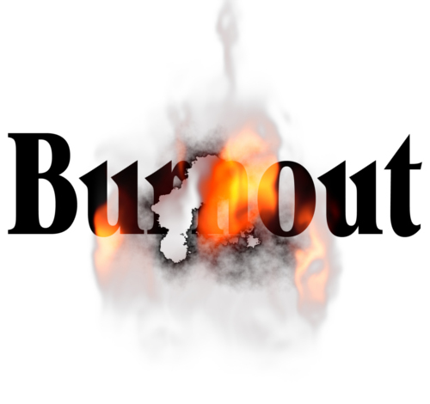
Burning Out
The psychological term for emotional exhaustion.
Exhaustion-persistent tiredness.
Cynicism-feeling negative about everything.
Inefficacy-the feeling that you just can’t get anything done.
The more a person smokes, the more burned out they get. It’s a cycle that leads to depression and addiction.
DISCUSSION: Have you experienced burnout from smoking? Has anyone you know experienced it?

Slide 15
Special Concerns With Adolescent Cannabis Use
Teens who smoke marijuana at least 1x/month are 3x as likely to have suicidal thoughts vs. non-users.
Prevalence of depression and anxiety increases with a higher rate of cannabis use, especially in young women.
Weekly marijuana users have 2x the risk of depression later in life.
Adults who first used marijuana at or before age 14 were 6x more likely to meet criteria for abuse or dependence than those who initiated use at 18 or older.

Slide 16
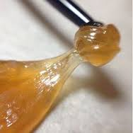
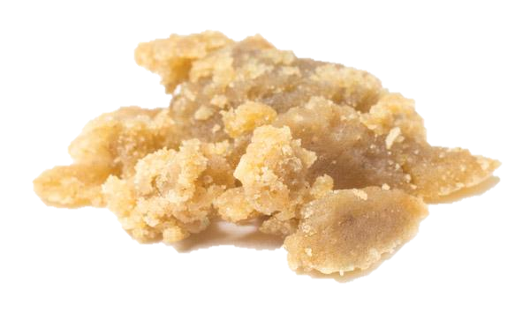
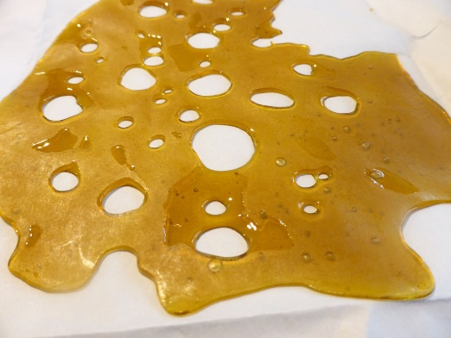
Marijuana Extracts
Dabbing: Smoking Hash Oil resins extracted from the marijuana plant made with butane.
Wax, Ear Wax, Oil, Honey Bowl, Butter, Dabs, Shatter
Notes:
Vaping has given rise to the use of new products. Marijuana extracts are created by boiling the green, leafy marijuana buds with butane fluid, a highly toxic and flammable substance. Marijuana extracts or has oils contain 4-5 times more THC and thus, are 4-5 times more addictive.

Slide 17
Dangers of Dabbing
The extraction process is dangerous. Creating a “dab lab” at home can result in explosions due to the combination of flammable gases and poor ventilation.
Hash oil made with butane or other chemical solvents contains chemical contaminants or excessive amounts of residual solvents that are inhaled into the lung tissue.
DISCUSSION:
Have you or someone you know tried dabbing or wax?
Have you noticed your tolerance level increasing faster?
Has your frequency of use changed? How?

Slide 18
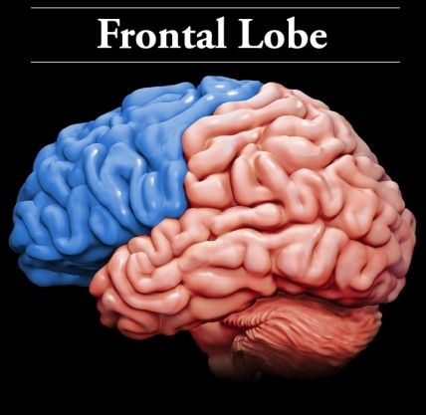
What will you gain if you wait…
Full executive functioning
Reduction in family arguments…maybe
Increase in attention and concentration
Increase in short-term memory ability
Anything else?

Slide 19
“We don’t smoke that s_ _ _. We just sell it. We reserve the right to smoke for the young, the poor, the black and stupid.” -Big Marijuana Executive at R.J. Reynolds

Slide 20
How will you protect your Frontal Lobe?

